Slide 1

Gigabit 101 Workshop

Slide 2
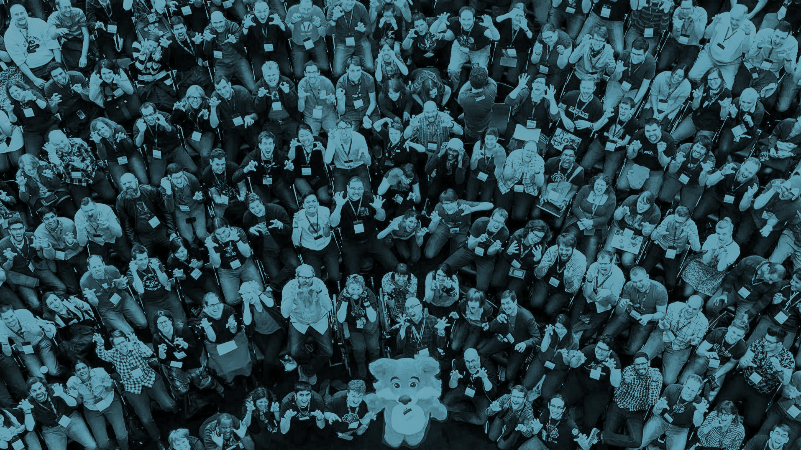
We strive to keep the Internet an
open and public resource for all

Slide 3
7 billion
World population
3,2 billion
Internet users
5 billion users
in next 5 years
Education.
Employment.
Finance.
Civic engagement.
Health.
Democracy.
http://www.internetlivestats.com

Slide 4
The rollout of high speed networks is shaping the future of the internet.

Slide 5
What story would you like to be able to tell about high speed internet?

Slide 6
Community Workshop
It’s part web literacy - What is the internet and how can it help us? Why should we learn about it?
It’s part gig advocacy - What does the high speed internet add? Why does it matter to equity and inclusion?
And, it’s part idea incubation: How can high-speed internet connections augment opportunities for all?

Slide 7
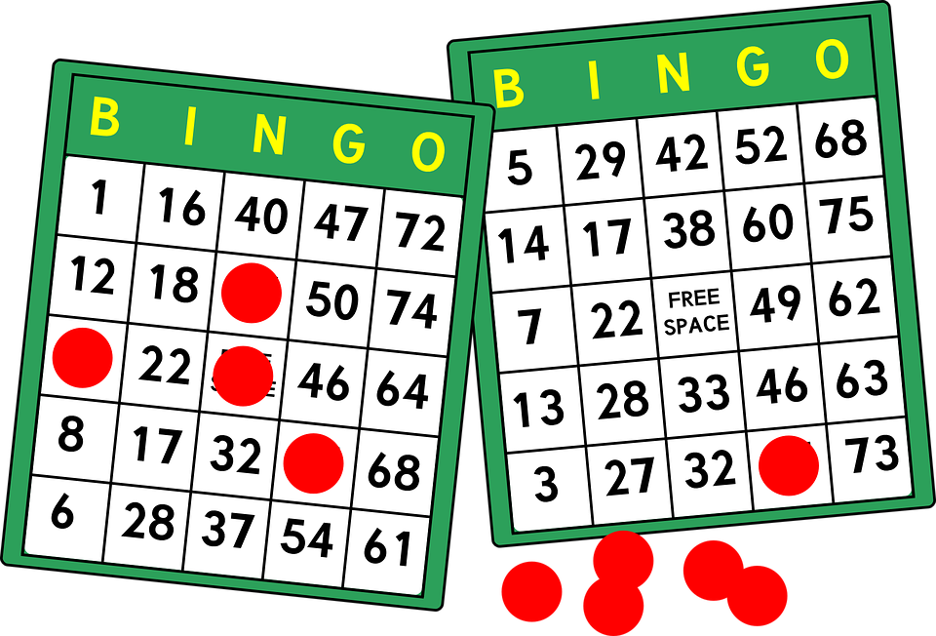
Web Literacy Bingo
Activity 1.

Slide 8
Spectogram
Activity 2.

Slide 9
Activity 2. Spectogram
Chocolate is the best ice cream flavor.

Slide 10
Activity 2. Spectogram
When someone says gigabit, I know what they’re talking about and would feel comfortable explaining it to someone else.

Slide 11
Activity 2. Spectogram
High speed networks are improving quality of life and impacting communities in positive ways.

Slide 12
Activity 2. Spectogram
High speed internet networks are creating new opportunities for my students/community.

Slide 13
Activity 2. Spectogram
Technology has the largest influence in shaping the future of learning.

Slide 14
Activity 2. Spectogram
I feel comfortable talking about emerging technologies.

Slide 15
Activity 2. Spectogram
It's easy to find people and resources to help me understand, build with, and use emerging technologies.

Slide 16
Activity 2. Spectogram
People I work with are excited about the potential of technology.

Slide 17
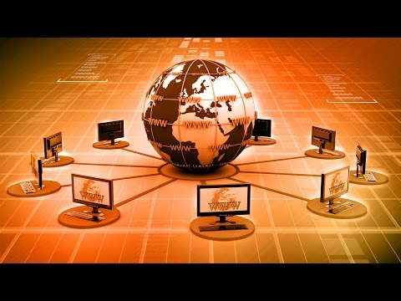
Understand the Web
Notes:
Video can be found here: https://thimbleprojects.org/chadsansing/125881/web-lit-basics-one/session02-ping-kong.html#step-2

Slide 18

Perform the Net
Activity 3.

Slide 19
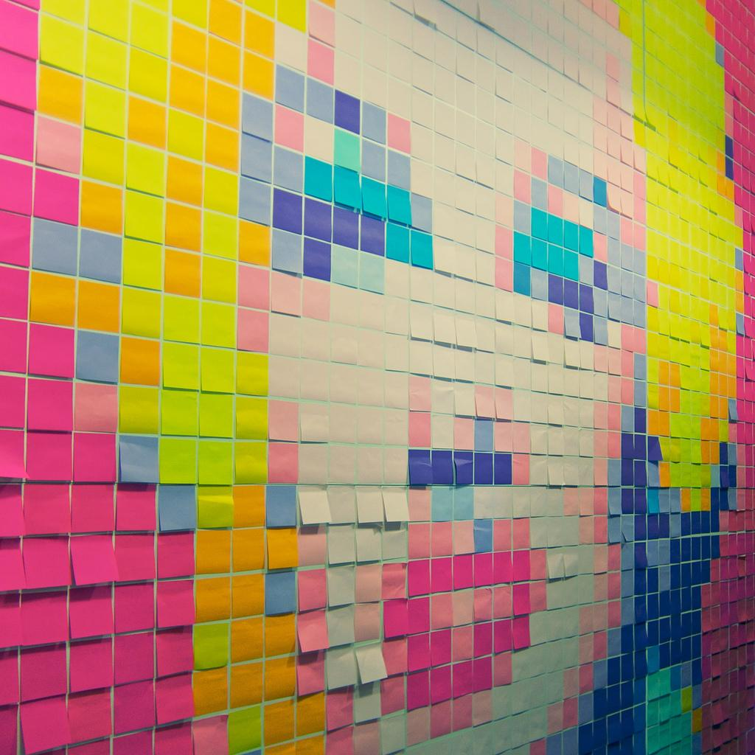
Sticky Note Art
Activity 4.

Slide 20

Speed Match
Activity 5.

Slide 21
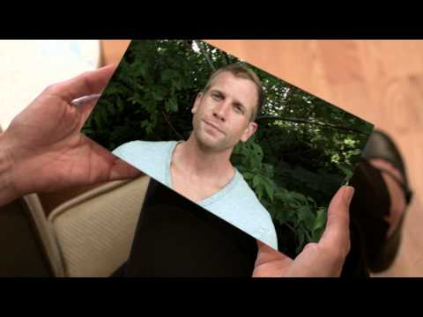
Dreaming About the Possibilities
Notes:
Video can be found here: https://drive.google.com/open?id=0B1Tu07mQk89LeHlMbkJjbzEwUnM

Slide 22
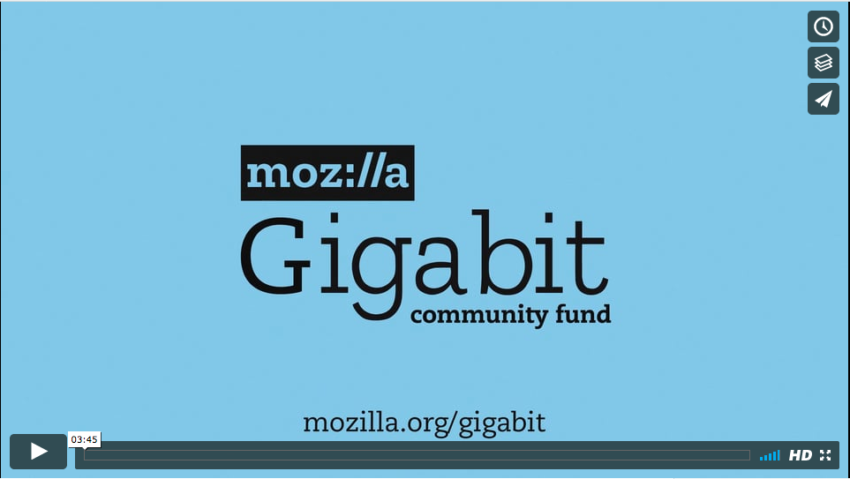
Mozilla Gigabit Community Fund
Notes:
Video can be found here: https://vimeo.com/204621980
More details on projects can be found here: https://learning.mozilla.org/en-US/gigabit/portfolio

Slide 23
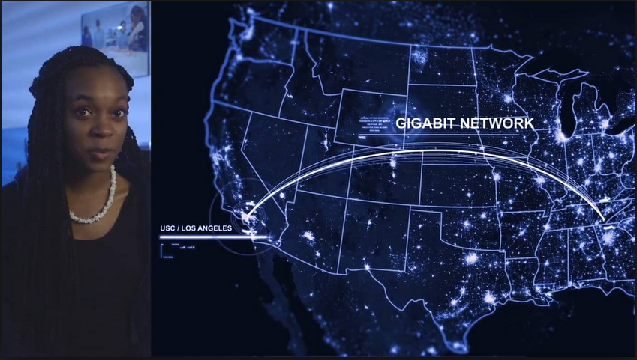
Mozilla Gigabit Community Fund
4K Microscopy
Students can remotely control a 4K microscope in Southern California and watch the ultra high-definition image change instantaneously - without having to wait through download times or buffering.
Chattanooga, TN

Slide 24
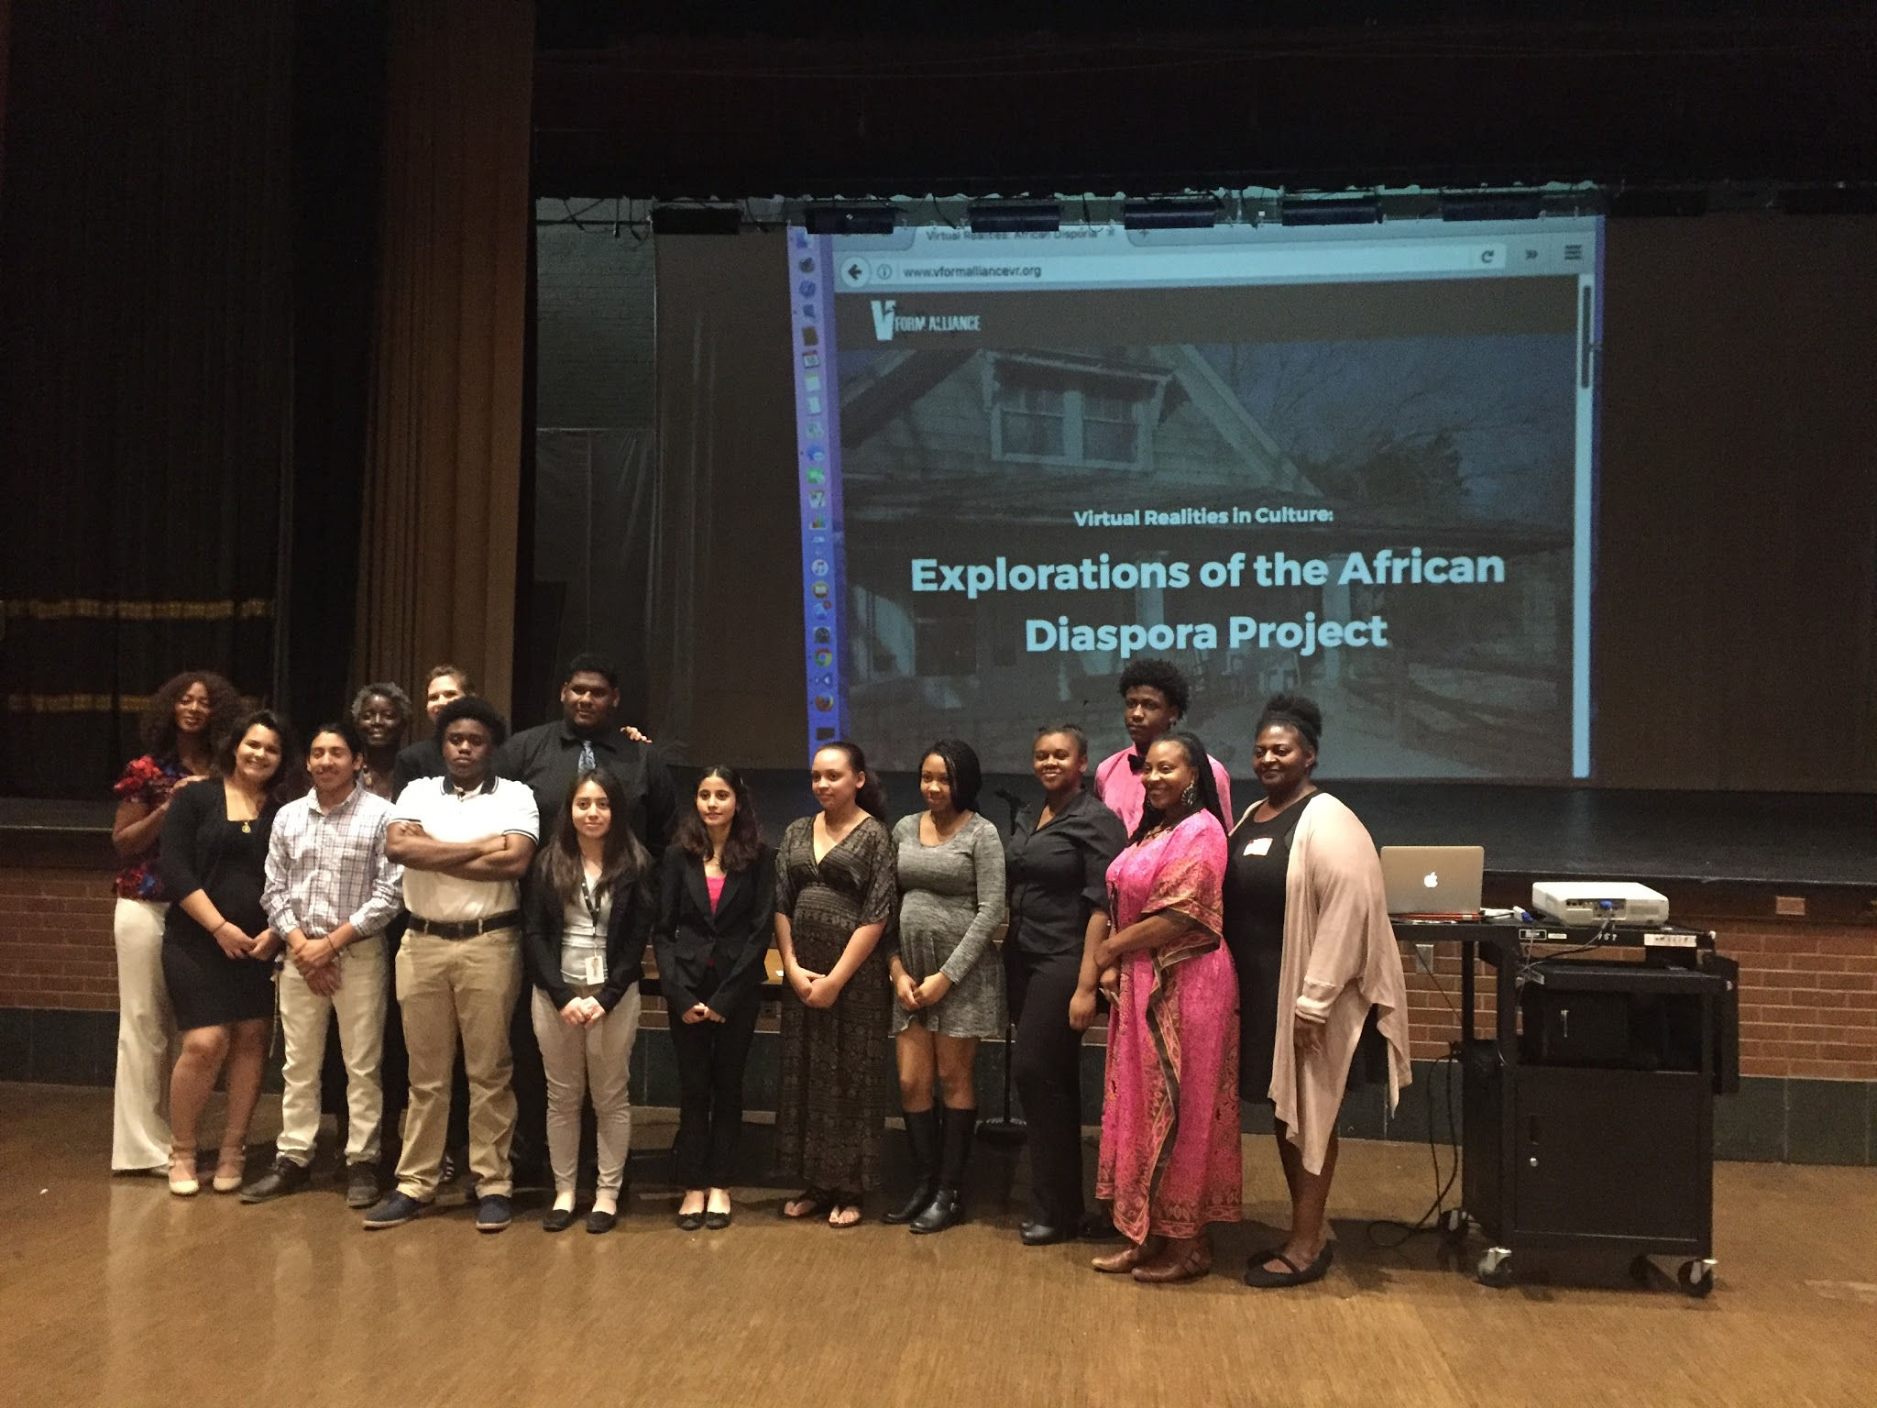
Mozilla Gigabit Community Fund
Virtual Realities in Culture
A project working with urban students in Kansas City to create virtual field trips to landmarks in Kansas and Missouri that are important to black history.
Kansas City

Slide 25
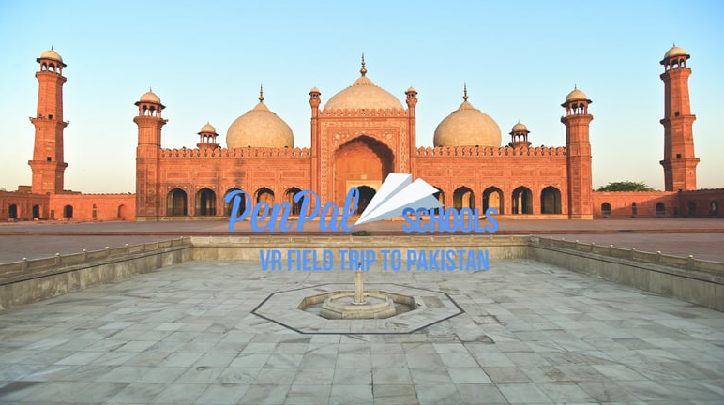
Mozilla Gigabit Community Fund
PenPal Schools
Using virtual reality to bring the world into the classroom, PenPal Schools is connecting students and facilitating cultural exchanges - like this field trip to Pakistan.
Austin, TX

Slide 26
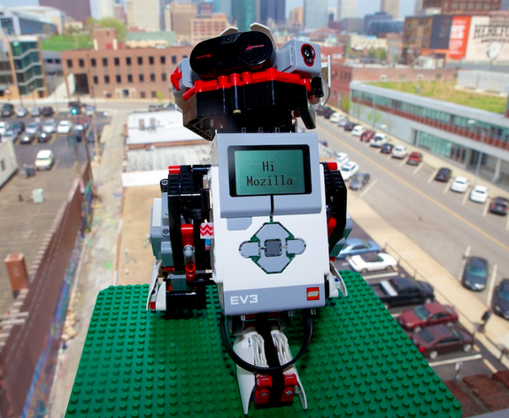
Mozilla Gigabit Community Fund
Gigabots
Bringing real-time internet connectivity and IoT technology to LEGO education robots in classrooms.
Kansas City + Austin

Slide 27
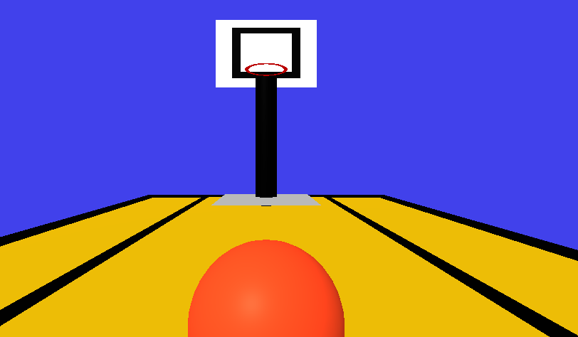
Mozilla Gigabit Community Fund
STEM + Virtual Reality
Bringing virtual reality and computer science education together to create an immersive environment for learning.
Austin, TX

Slide 28
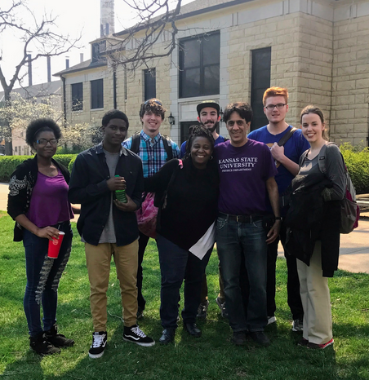
Mozilla Gigabit Community Fund
CERN + KC Gigabit
Citizen science meets supercomputing to support data analysis for physics research being conducted in the Large Hadron Collider at CERN.
Kansas City

Slide 29
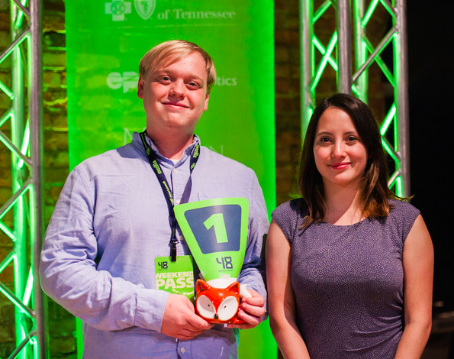
Mozilla Gigabit Community Fund
Viator
A startup in Chattanooga is creating immersive environments for learning foreign languages.
Chattanooga, TN

Slide 30


Let’s Gigovate
Activity 7.

Slide 31

A Gig Idea
Activity 8.

Slide 32

What’s possible
Share your ideas!

Slide 33

Activity 9. Gigovate
Create a project canvas/roadmap

Slide 34
Reflection
Questions or ideas from your notecards?
What is one thing you are going to do after this workshop?
What is something you learned or are taking away from this session?
Notes:
Have participants fill out Feedback Form

Slide 35
A Few Useful Resources
learning.mozilla.org/gigabit
mzl.la/MozGigVid
Also, we’d love your feedback!
Notes:
Refer to printed Resources document

Slide 36
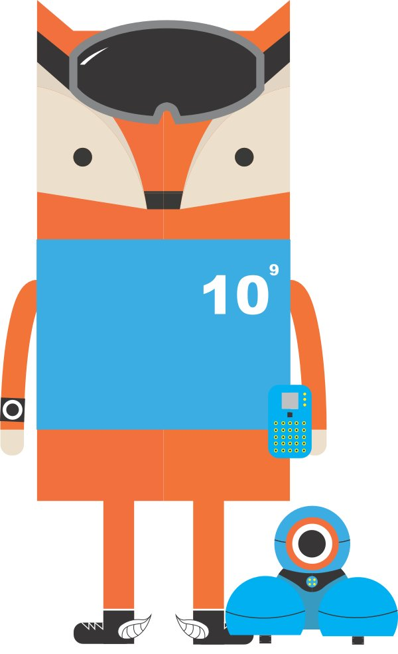
Thank you.

